Slide 1
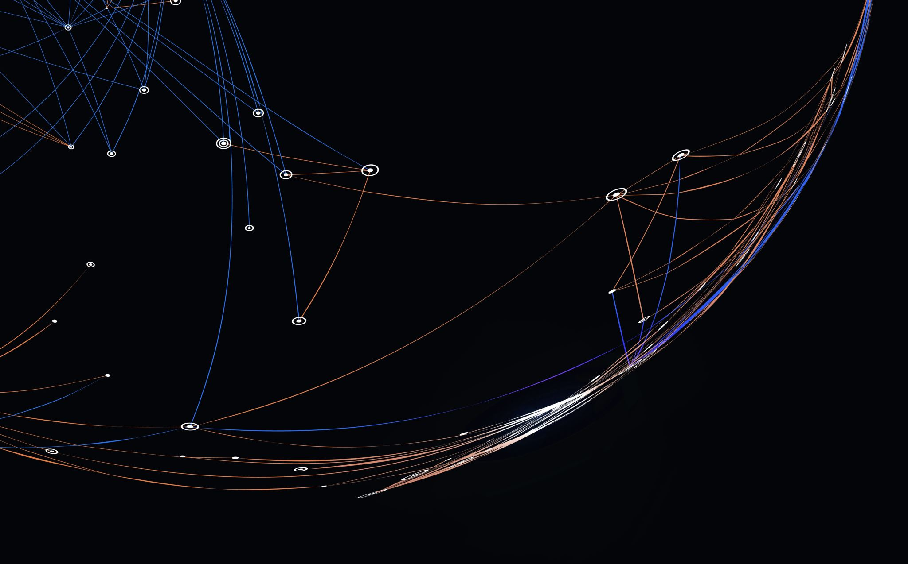
k-Nearest Neighbors
Group 5: Kripanjali Dhungana, Jack Lynn, Norman Morris, & Sam Wainright

Slide 2
K-nearest Neighbors (k-NN)
Supervised learning
Can be used for regression and classification algorithms
Instance-based learning (lazy learning)
Based on the assumption that like instances are the closest distance to one another
Uses voting mechanism: k-nearest instances vote to classify an unknown instance

Slide 3
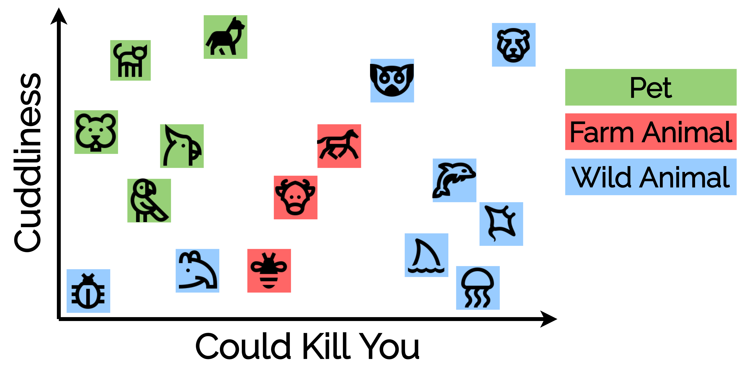

Slide 4
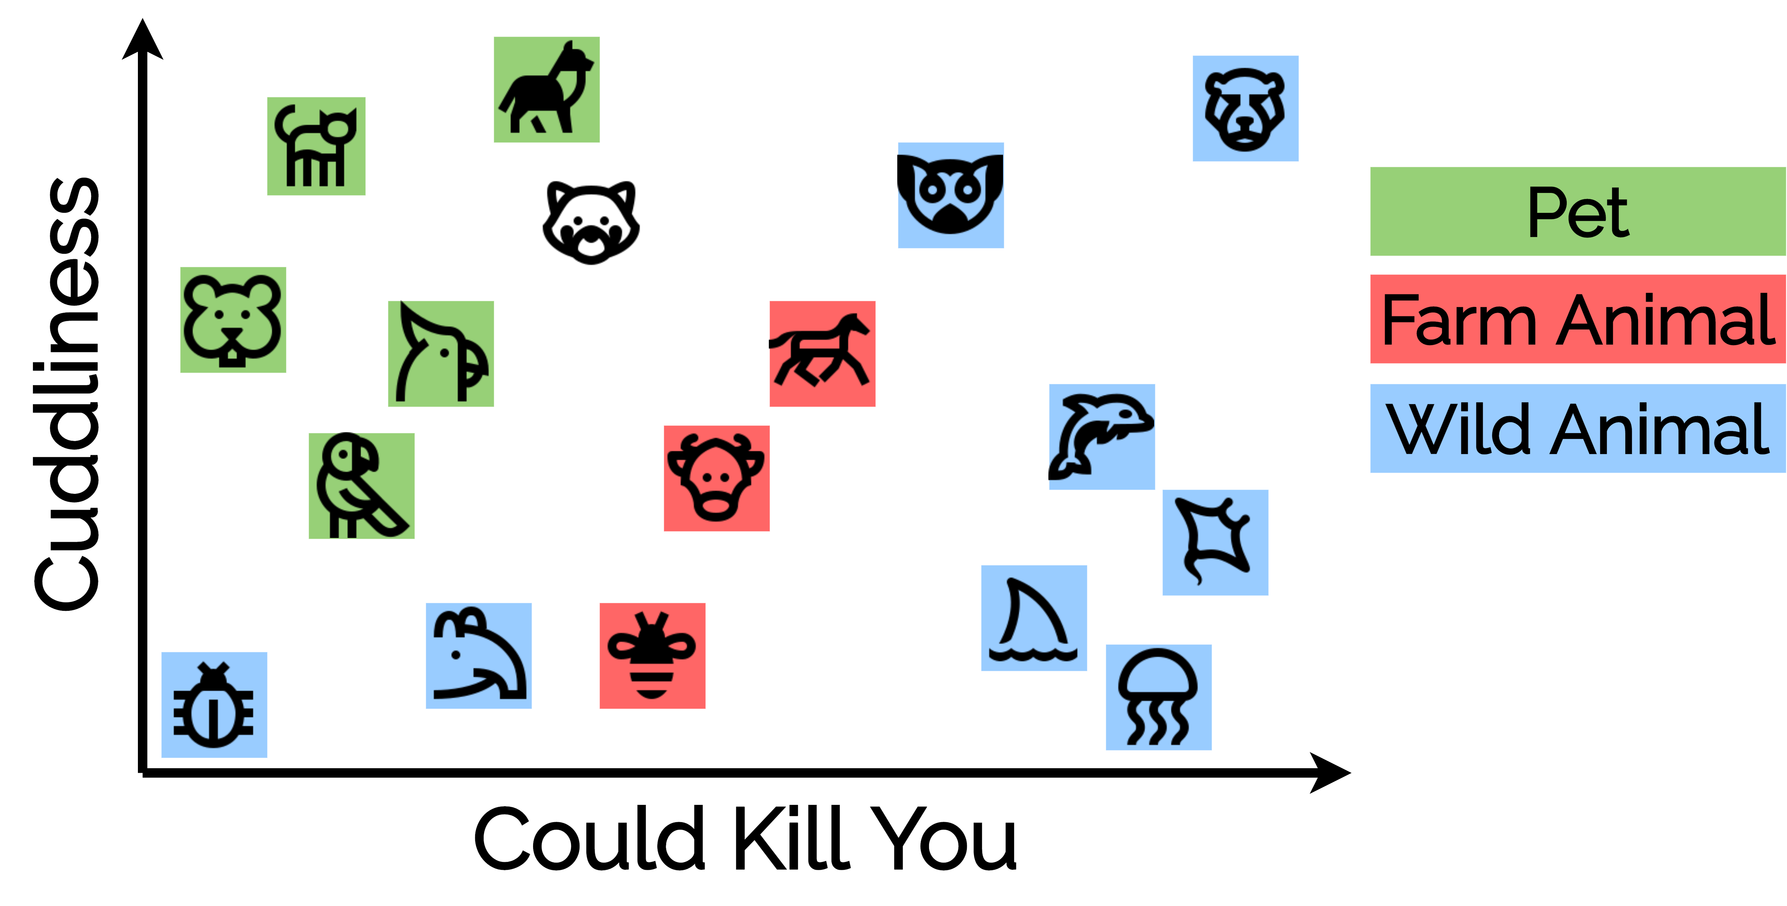

Slide 6
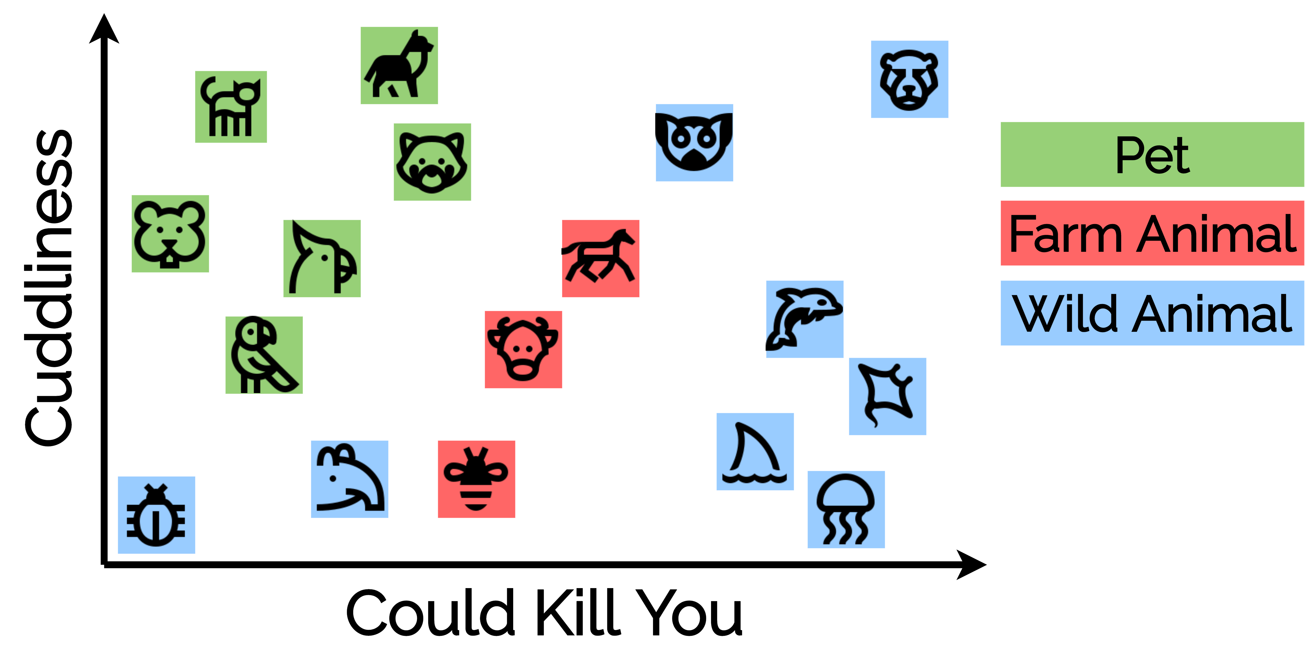

Slide 7
Preprocessing: Interpolation and Nan Handling
Mean interpolate any unknown numeric values (optional)
Mode interpolate any unknown categorical values (optional)
Remove any completely unique columns (e.g., names, IDs…)
Convert all categories to numeric values
Make need to consider the values of being part of category
E.g.: extremely rare category could be given a weight stronger than 1

Slide 8
Preprocessing: Normalization
Normalization of data is REQUIRED
Why?
Distance is evaluated by the relative difference between points
Points with greater unit values will be more heavily weighted
B (2, 0.03)
$$\overline{AB}=\sqrt{{\left(2−1\right)}^{2}+{\left(0.03−0.01\right)}^{2}}=1.0002$$
C (1.2, 0.10)
$$\overline{AC}=\sqrt{{\left(1.2−1\right)}^{2}+{\left(0.10−0.01\right)}^{2}}=0.2193$$
A (1, 0.01)

Slide 9
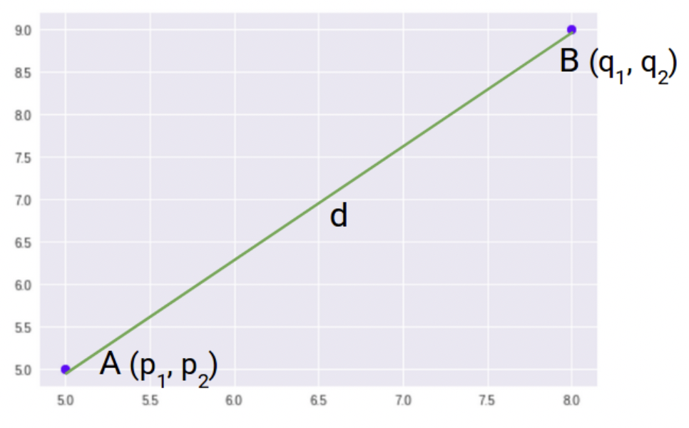
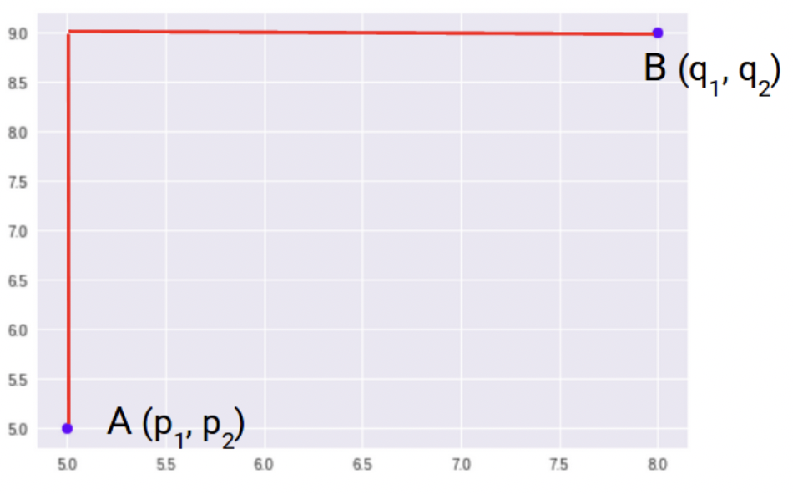
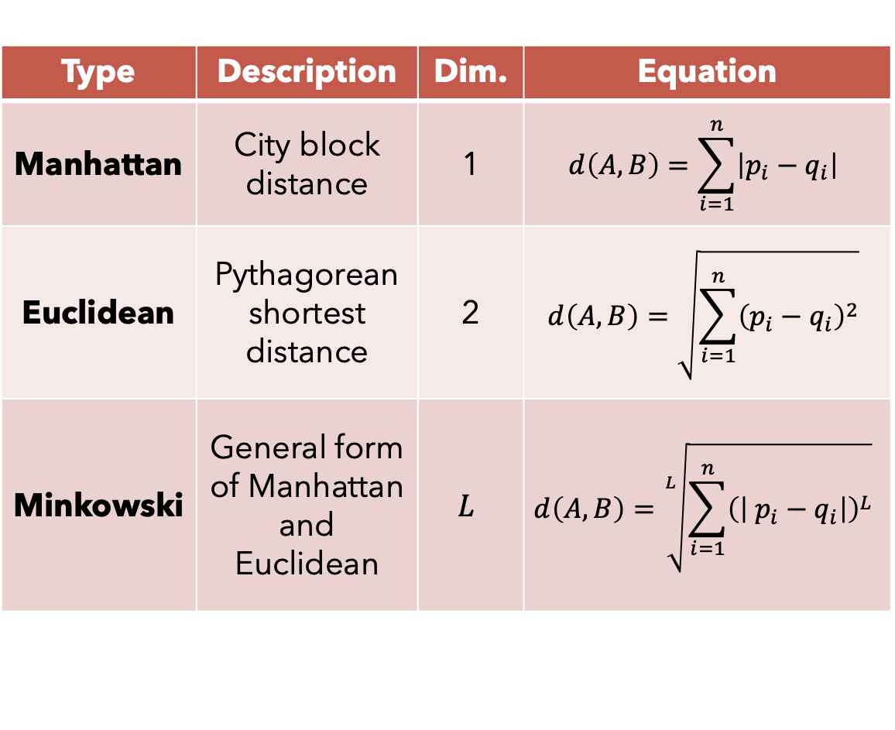
Hyperparameters: Distance
Euclidean
Type | Description | Dim. | Equation
Manhattan | City block distance | 1 | $$d\left(A,B\right)=\sum_{i=1}^{n}{\left|p_{i}−q_{i}\right|}$$
Euclidean | Pythagorean shortest distance | 2 | $$d\left(A,B\right)=\sqrt{\sum_{i=1}^{n}{{\left(p_{i}−q_{i}\right)}^{2}}}$$
Minkowski | General form of Manhattan and Euclidean | $$L$$ | $$d\left(A,B\right)=\sqrt[L]{\sum_{i=1}^{n}{{\left(\left| p_{i}−q_{i}\right|\right)}^{L}}}$$
Manhattan

Slide 10
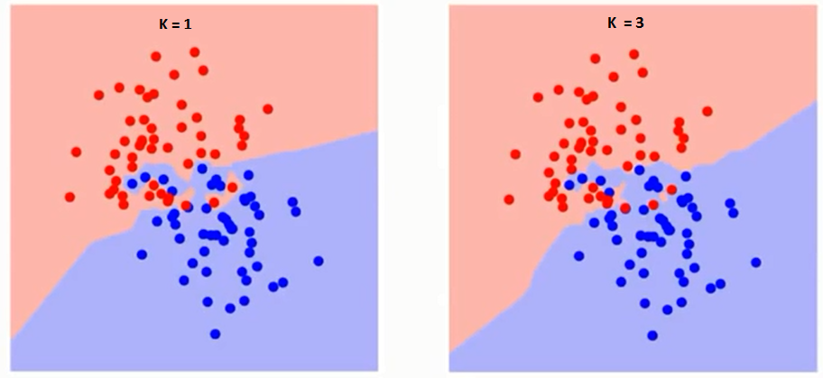
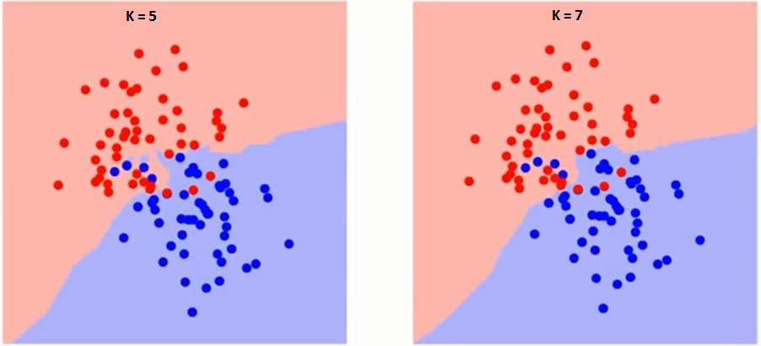
Hyperparameters: K
K: number of nearest neighbors involved in classification
Overfitted: too small K
Underfitted: too large K
Underfit
Overfit

Slide 11
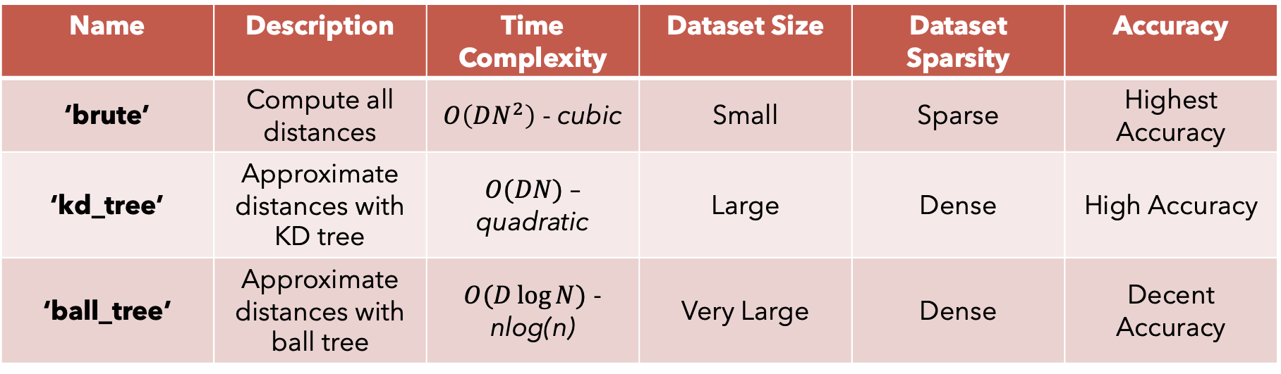
Hyperparameters: Algorithms
Change the how distance is calculated (to save time)
Also tuned with ‘leaf_size’
Name | Description | Time Complexity | Dataset Size | Dataset Sparsity | Accuracy
‘brute’ | Compute all distances | $O\left(DN^{2}\right)$ - cubic | Small | Sparse | Highest Accuracy
‘kd_tree’ | Approximate distances with KD tree | $O(DN)$ – quadratic | Large | Dense | High Accuracy
‘ball_tree’ | Approximate distances with ball tree | $O(D\log{N})$ - nlog(n) | Very Large | Dense | Decent Accuracy

Slide 12
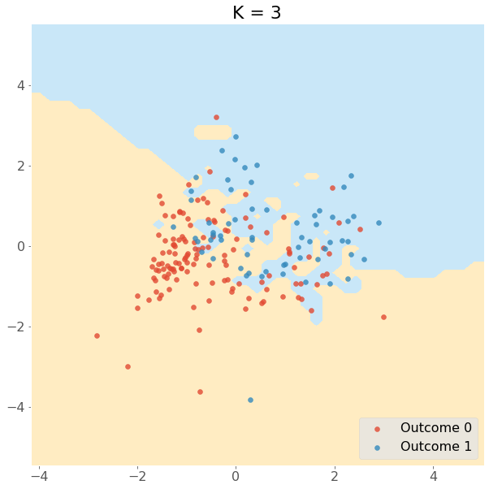

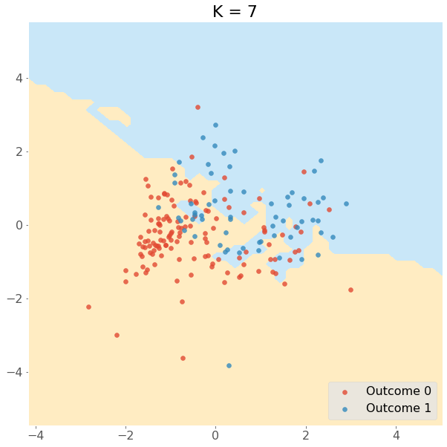

Benefits
Intuitive and human friendly
Allows user to chose the hyperparameters
Memory-based
Both classification and regression
Ease after establishing hyperparameters
Non-parametric
Notes:
Intuitive and human friendly
Minimal model interpretation
More complex models need more data that is sometimes not available. K-nn can work with very little data
Hyperparameters:
Only need to implement k-value and distance function
Memory based/No new model
New data is tagged and the algorithm learns at prediction
New data contributes to the evolution of the algorithm
Both for classification and regression:
Classify things as either right or wrong and predict the probability of the data being in a certain class
Ease after establishing
After finding and establishing optimal hyperparameters everything else will align to it
As new values are added, knn adjusts based on the n-neighbors provided
Non-parametric:
Knn does not make assumptions about the dataset. Which is beneficial if you don’t know a lot about the dataset.
Non assumptive can discover hidden relations in data

Slide 13
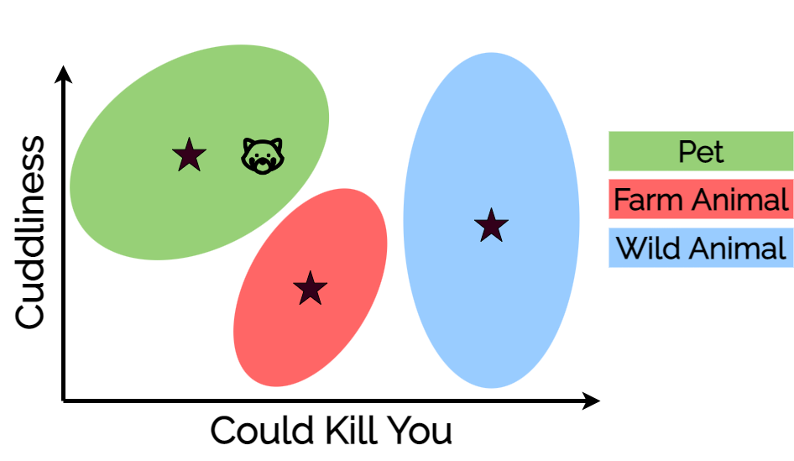
Trade-offs and limitations
Non-parametric
Slow to implement
Dimensionality
Requires homogenous features
Sensitive to outliers
Notes:
K=3 is overfit
Non-parametric:
Does not make assumptions about the dataset and therefore all assumptions are given equal treatment.
Imbalanced data within our three classes means that the class that has more data (wild-animals) is given preference
Less common class (farm animals) are wrongly classified
Include stratify
Slow to implement
Does not work well with large datasets as calculating the distances between each data is costly
Only have to choose k-value and distance function but necessary to find what those optimal values are first
Dimensionality
Best for small dimensions only
Problematic for datasets with many features
A dataset with 1 million rows with a 30/70 training split, knn will have to calculate 100 subtraction, 100 squares, and 1sq. root for all 700k training rows
Problematic for an algorithm that evolves and as it acquires new data
Homogenous features
Data cleaning and processing especially important: scaled features, sensitive to outliers, no capability of dealing with outliers
If using Euclidian or Manhattan distances it’s necessary that features are scaled since absolute differences in features weigh the same
Sensitive to outliers
- Will simply choose neighbors based on distance criteria

Slide 14
Questions?

